Slide 1
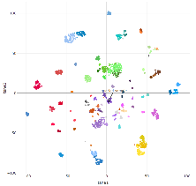
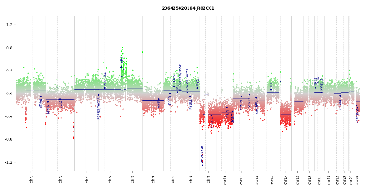
O perfil de metilação do DNA como ferramenta para a medicina de precisão em Sarcomas
Felipe D’Almeida Costa, MD, PhD
Coordenador Médico de Educação em Patologia da Dasa
Patologista do A.C.Camargo Cancer Center
Vice-Presidente para Assuntos Acadêmicos da Sociedade Brasileira de Patologia
felipedalmeida@yahoo.com.br
@FelipePatologia

Slide 2
Disclosure*
De acordo com a Norma 1595/2000 do Conselho Federal de Medicina e com a RDC 96/2008 da ANVISA, declaro que:
Atuo em Neuropatologia e Patologia de Partes Moles na DASA, tendo participado diretamente da validação e implementação do teste de Perfil de Metilação do DNA.
Apresentações: como palestrante convidado, participarei de evento da Illumina.
Não possuo ações de quaisquer destas companhias.
Os meus pré-requisitos para participar destas atividades são a autonomia do pensamento científico, a independência de opiniões e a liberdade de expressão.
The opinions expressed during this presentation are those of the speaker and may not represent the opinions of Illumina. Any uses of Illumina’s products described in this presentation may be uses that have not been cleared or approved by the FDA or any other applicable regulatory body.
*De acordo com RDC 96/2008 ANVISA

Slide 3
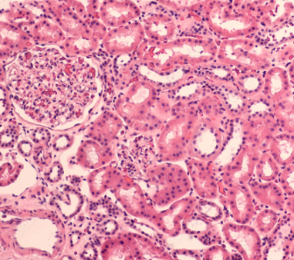
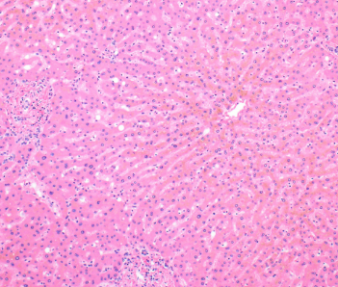
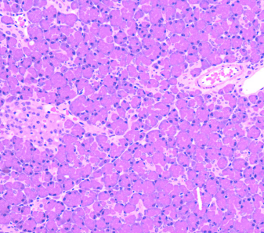
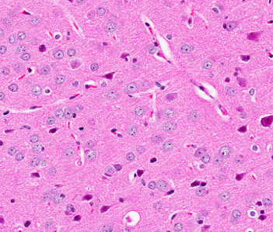
What is the genomic difference between them?

Slide 4
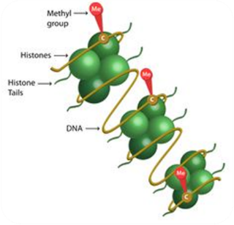
DNA methylation
Methylation occurs by the introduction of a methyl group at the 5' position of the cytosine ring forming 5-methylcytosine (5mC), catalyzed by methyltransferases (DNMTS)
Occurs mainly in CpG dinucleotides (CPG islands)

Slide 5
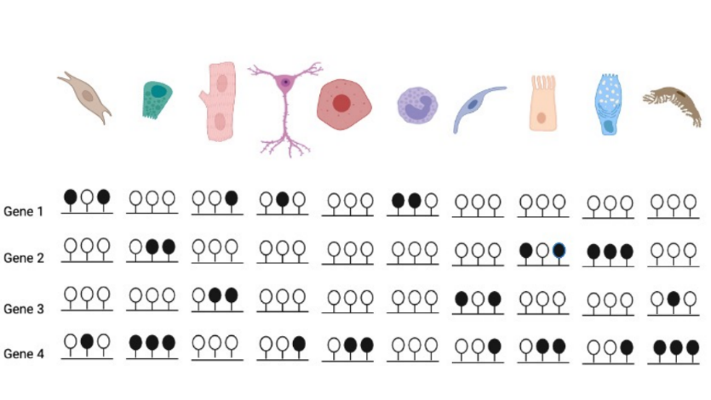
Cell types and methylated genes

Slide 6
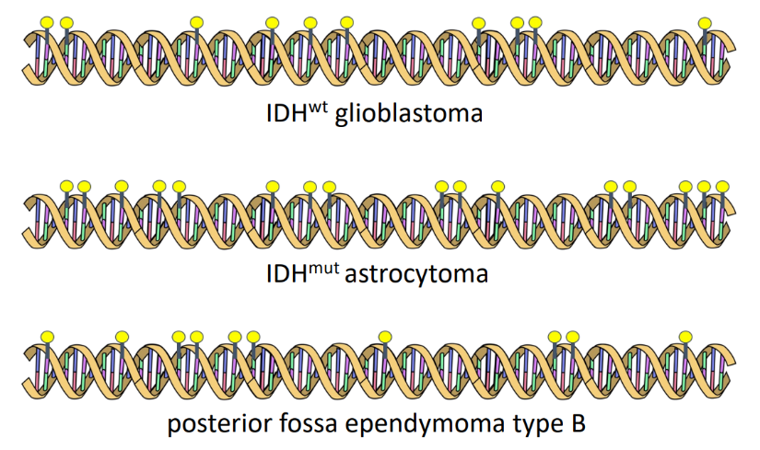
Tumor types and methylation profiles
Ewing Sarcoma
Rhabdomyosarcoma
Dedifferentiated Liposarcoma

Slide 7
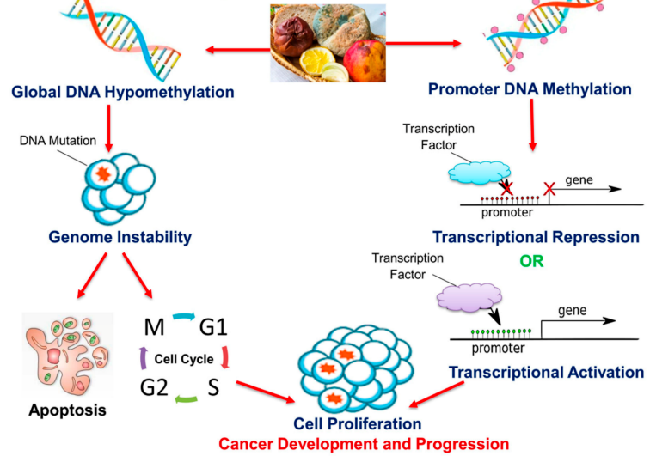
dynamic transcriptional landscape
Adapted from Souza & Noushmehs, 2018; Ghazi et al, 2020

Slide 8
Relatively small sample size in biopsies
More than 100 WHO entities
Morphological overlap between tumor types
Many tumor types without specific IHC markers
Around 60% lack gene fusions
Few specialized pathologists
High inter-observer variability
Diagnostic challenge for sarcomas

Slide 9
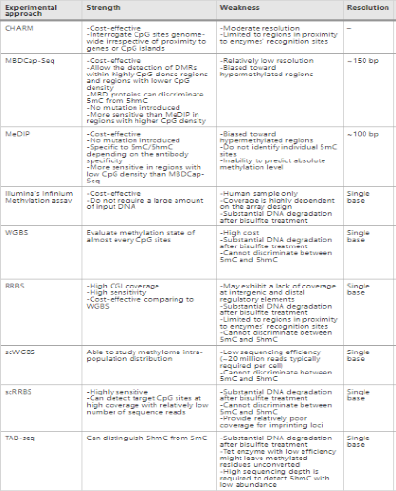
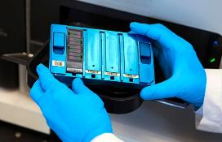
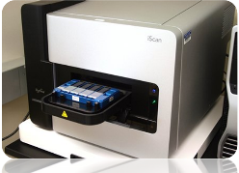
The methylome dynamic in clinical practice is analysed in routine through arrays
BeadChip and EPIC (Illumina)
Adapted from Ghazi et al, 2020

Slide 10
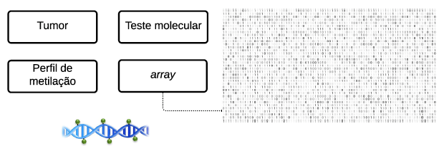

Slide 11
Tumor classification through DNA methylation profiling (CNS, Sarcomas, Sinonasal and Skin Tumors)
Raw data
(Beadchip/EPIC)
+
Methylation profiling classifier
(machine learning platform)
https://www.molecularneuropathology.org/mnp

Slide 12
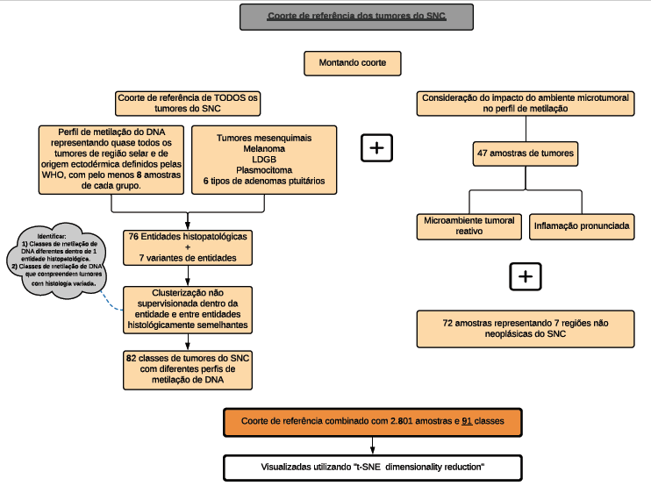

Slide 13
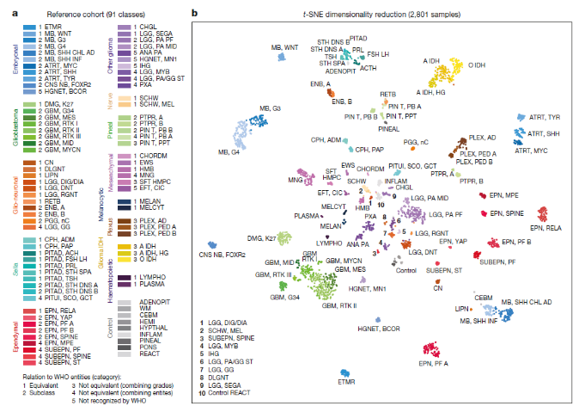

Slide 14
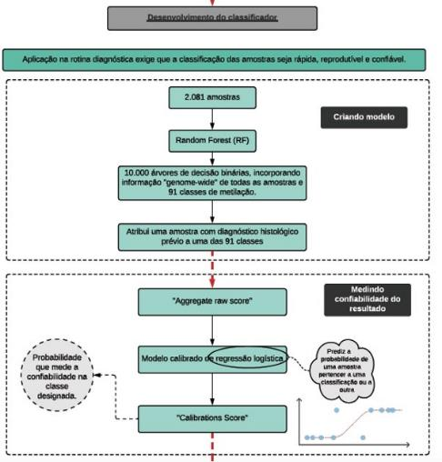
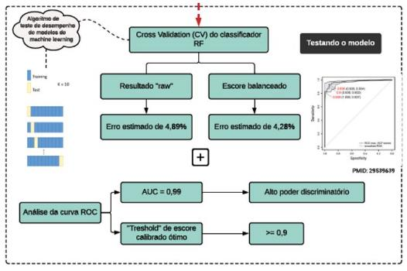
Cut-offs:
>0.9 for a tumor family
>0.5 for a subclass within a family

Slide 15
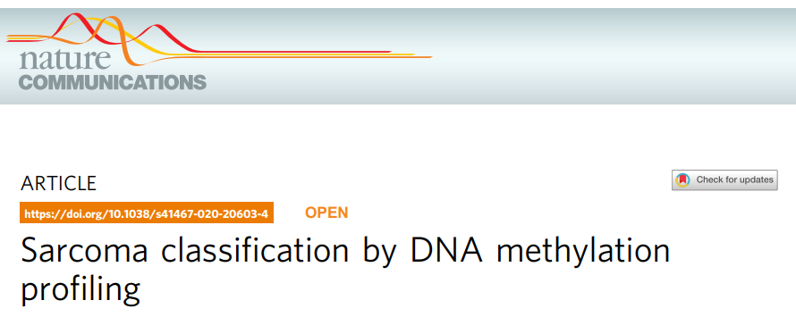
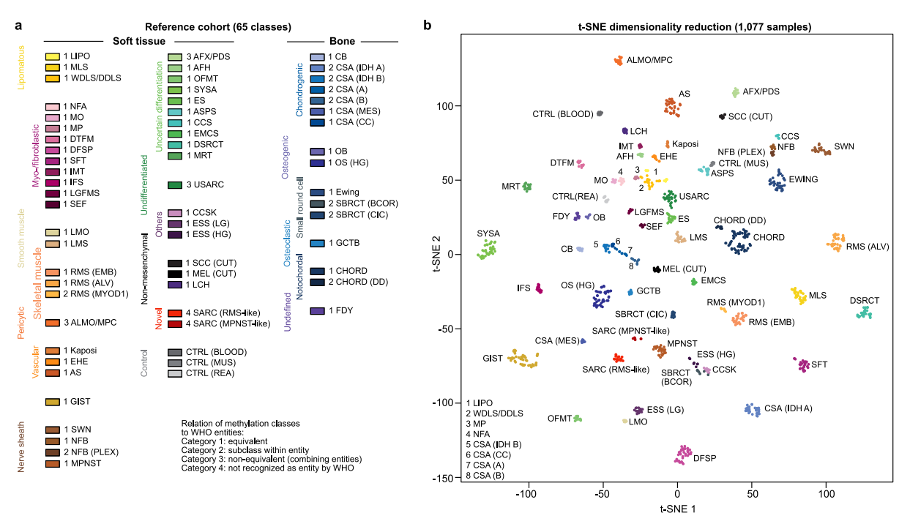
Nature Communications | (2021) 12:498

Slide 16
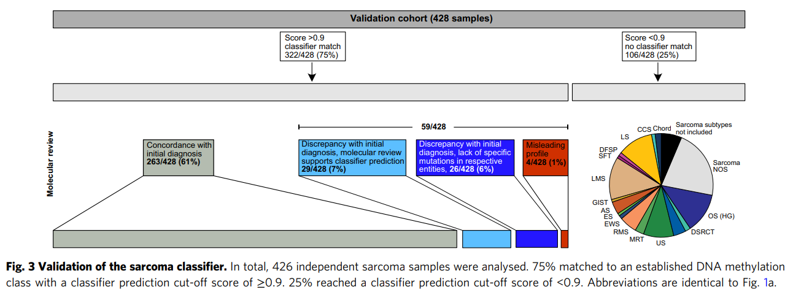
Nature Communications | (2021) 12:498

Slide 17
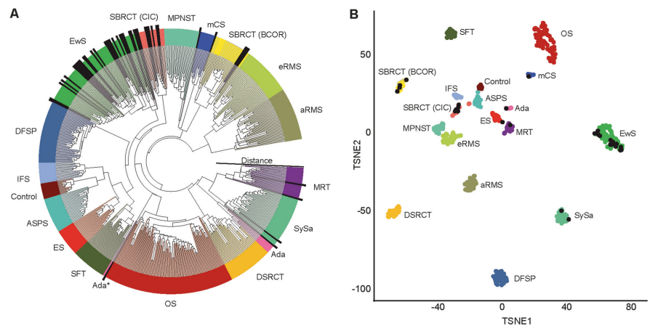

Slide 18
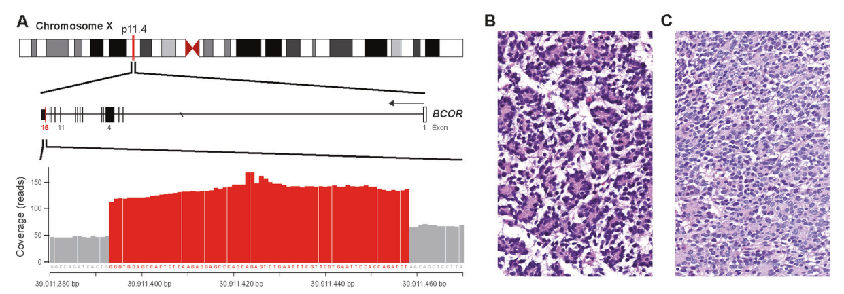

Slide 19
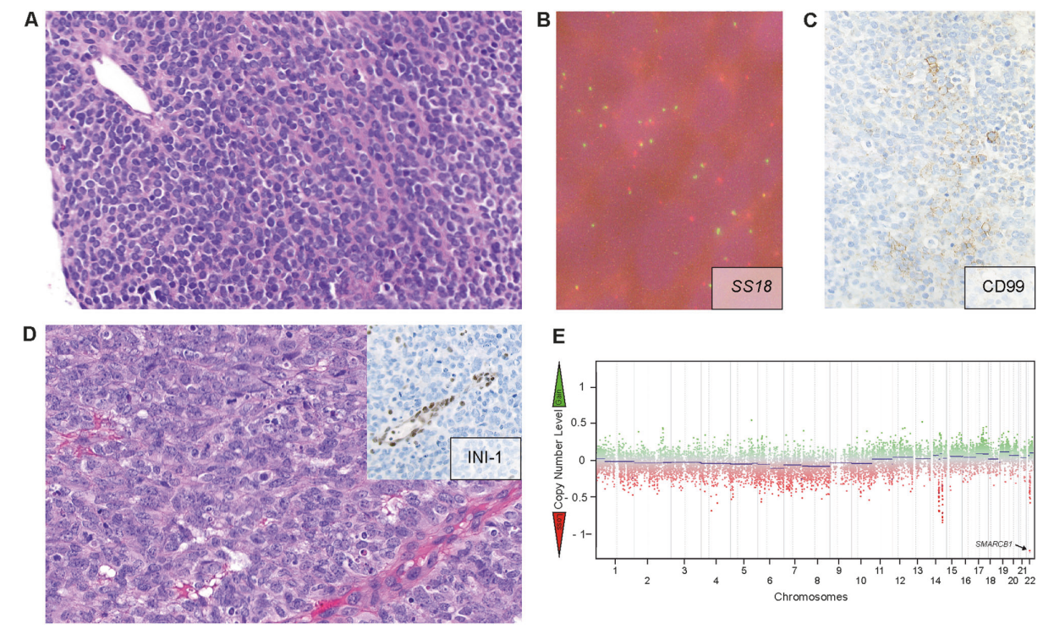

Slide 20
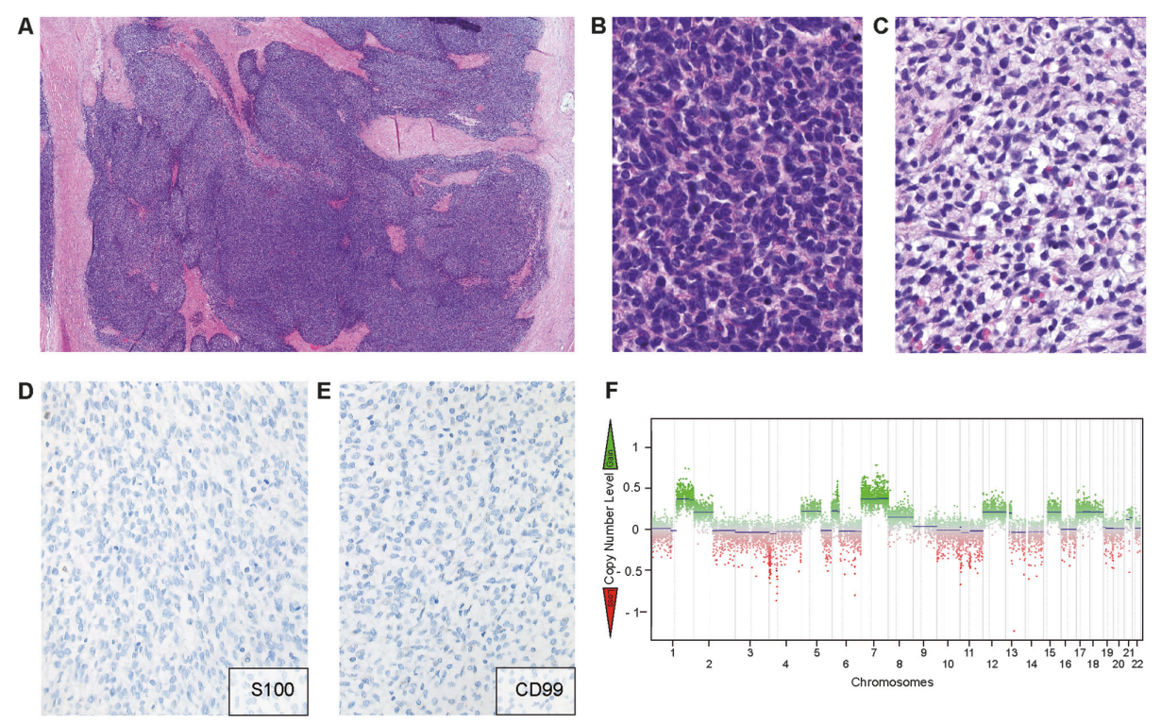

Slide 21
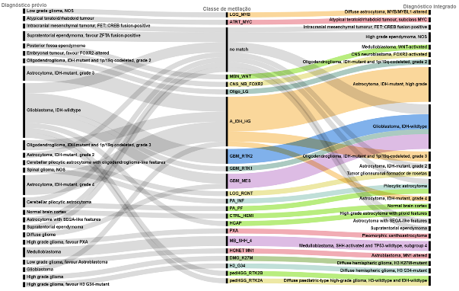
Validation of Methylation Profiling in Brazil
Match score (>0.84): 79,5%
Discordant cases: 14.3%
Refined diagnosis: 34.3%
Of 9 cases with no match, 1 was a new entity not yet included in the classifier (Intracranial mesenchymal tumor, FET::CREB fusion positive)
Costa FD, et al. Brazilian Congress of Clinical Oncology, 2022

Slide 22
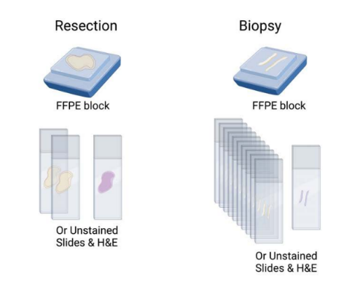
Specimen types

Slide 23
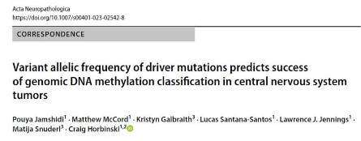
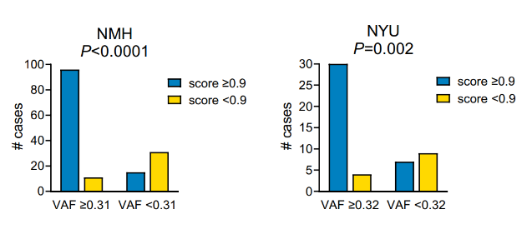
Cellularity matters
Ideal cellularity is at least 60%

Slide 24
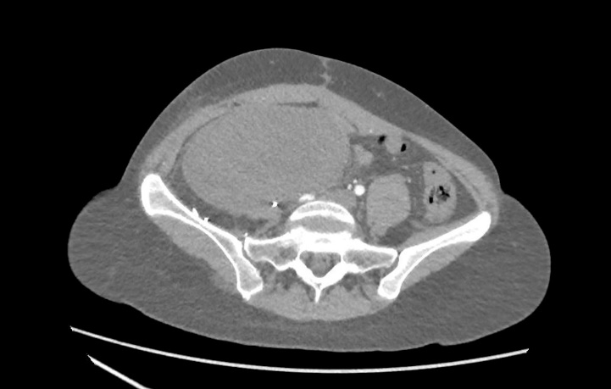
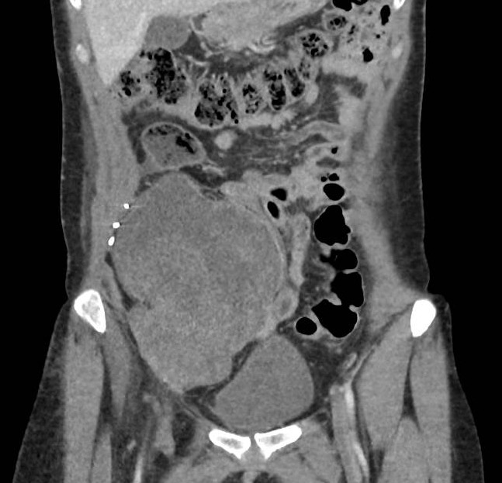
Case 2
Case 1
Female
22-year-old
Recurrent pelvic mass

Slide 25
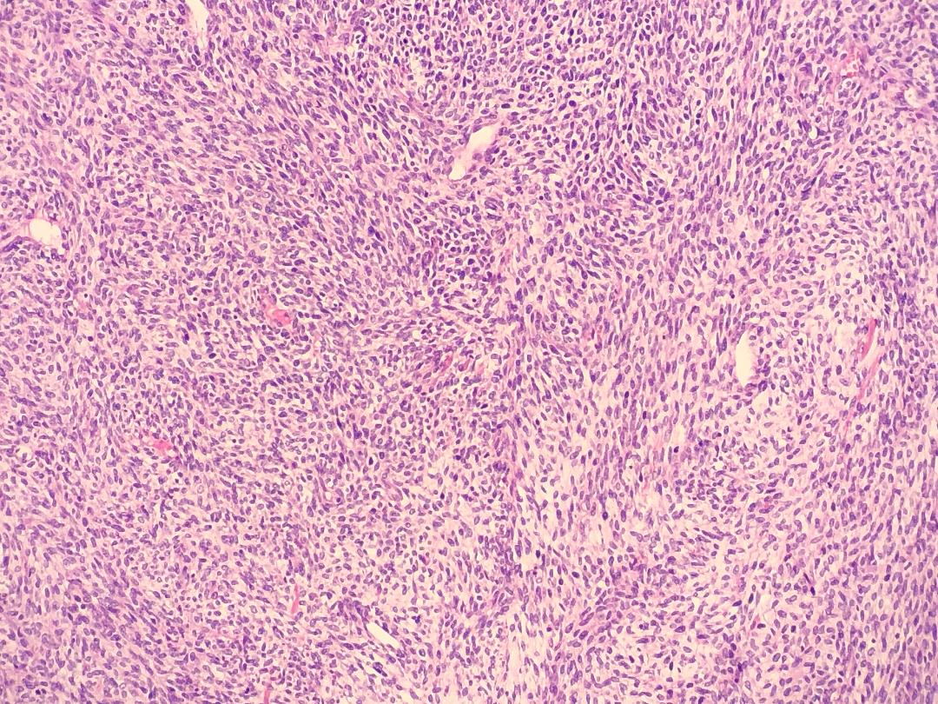
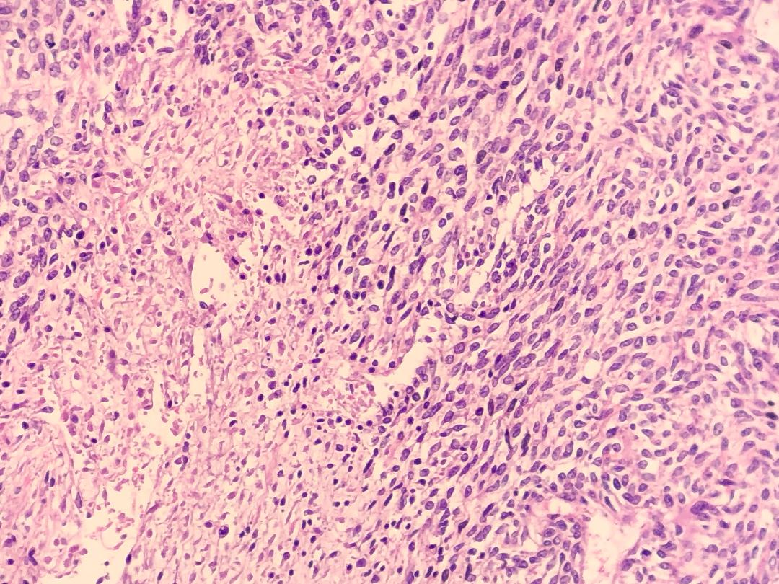
Case 2

Slide 26
Case 2
Diagnosis
High grade spindle cell sarcoma

Slide 27
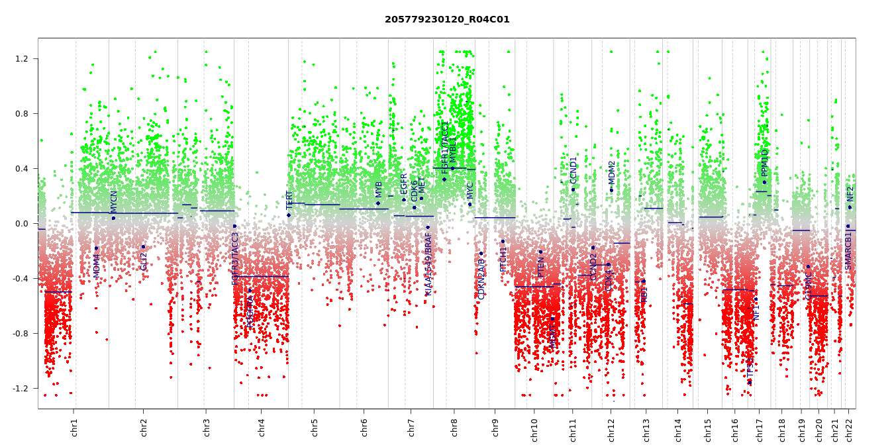
Case 2
Methylation profiling
and
Copy number variation
Analysis
https://www.molecularneuropathology.org/

Slide 28
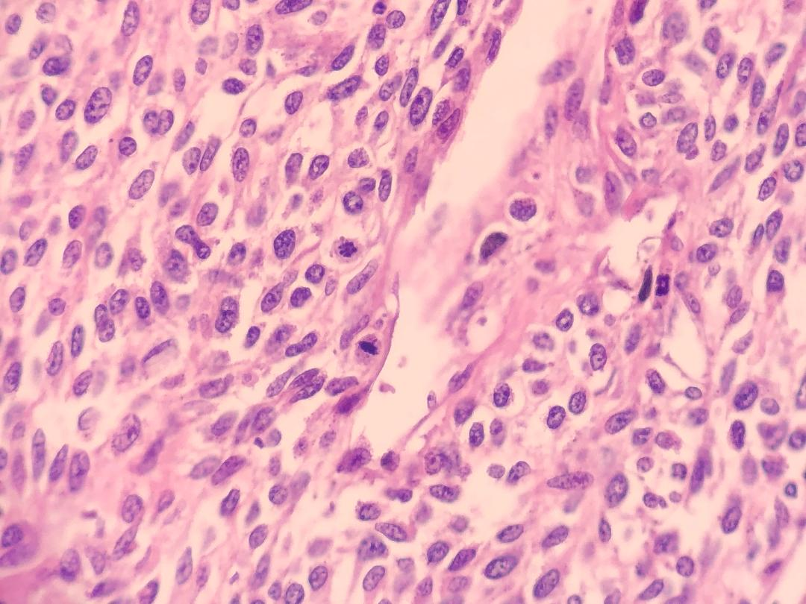
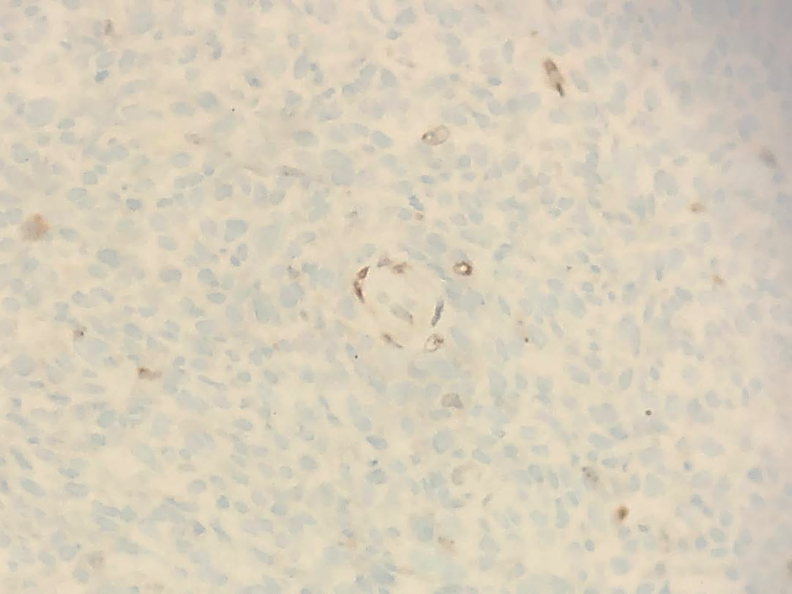
Case 2
H3 K27me3

Slide 29
Case 2
Integrated Diagnosis
Integrated diagnosis: Malignant peripheral nerve sheath tumor, high grade.
Histopathological classification: Spindle cell sarcoma.
WHO grade: 3.
Molecular findings: Methylation class MPNST (calibrated score 0,99), several gains and losses (including 17p loss involving NF1 gene).

Slide 30
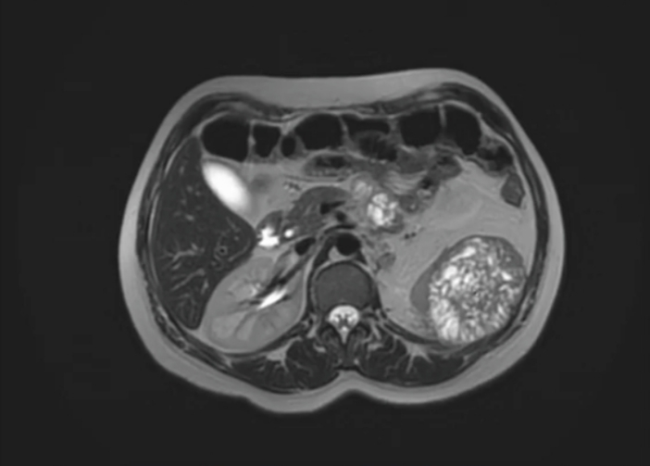
Case 2
Case 2
Female
32-year-old
Recurrent retroperitoneal tumor
Previously diagnosed as Ewing Sarcoma

Slide 31
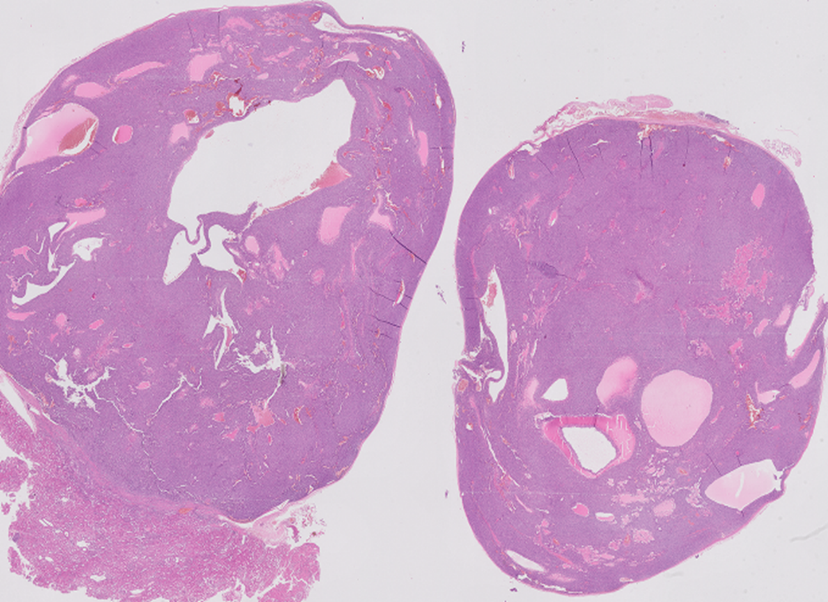
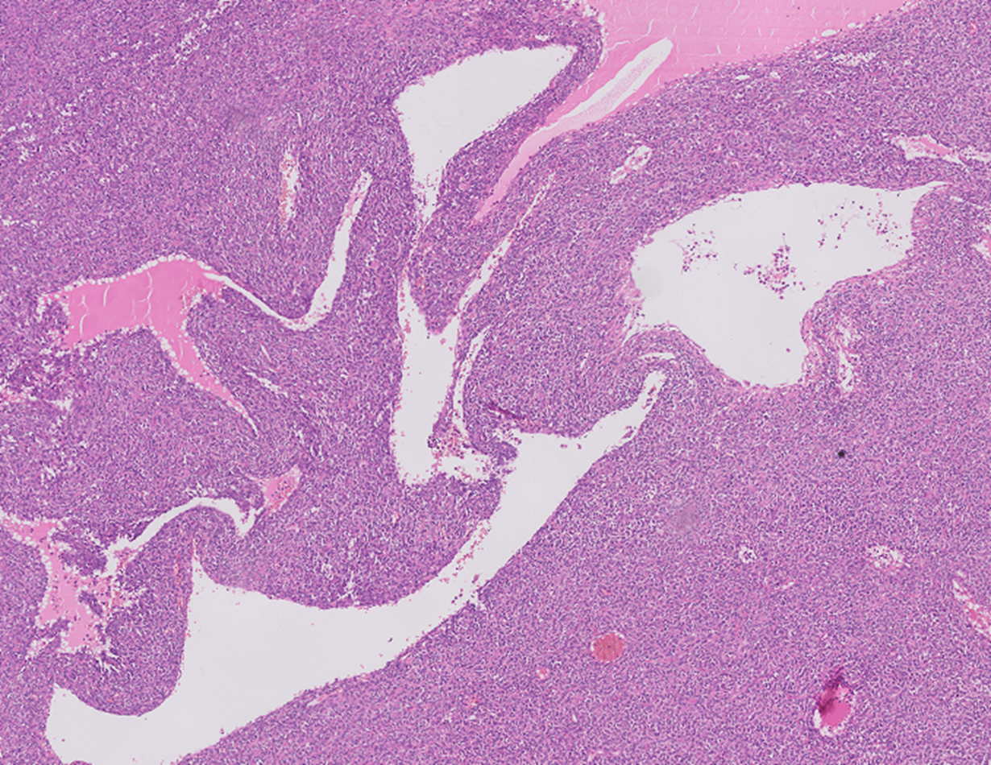
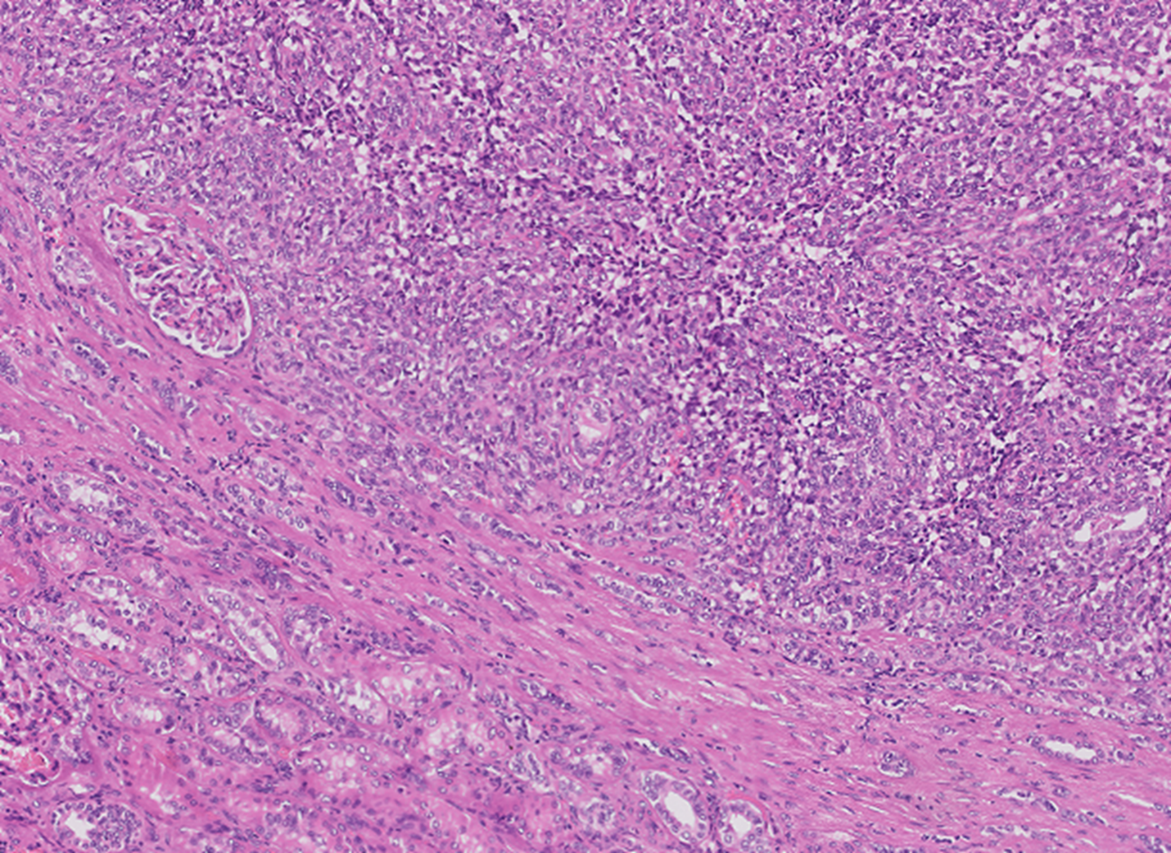
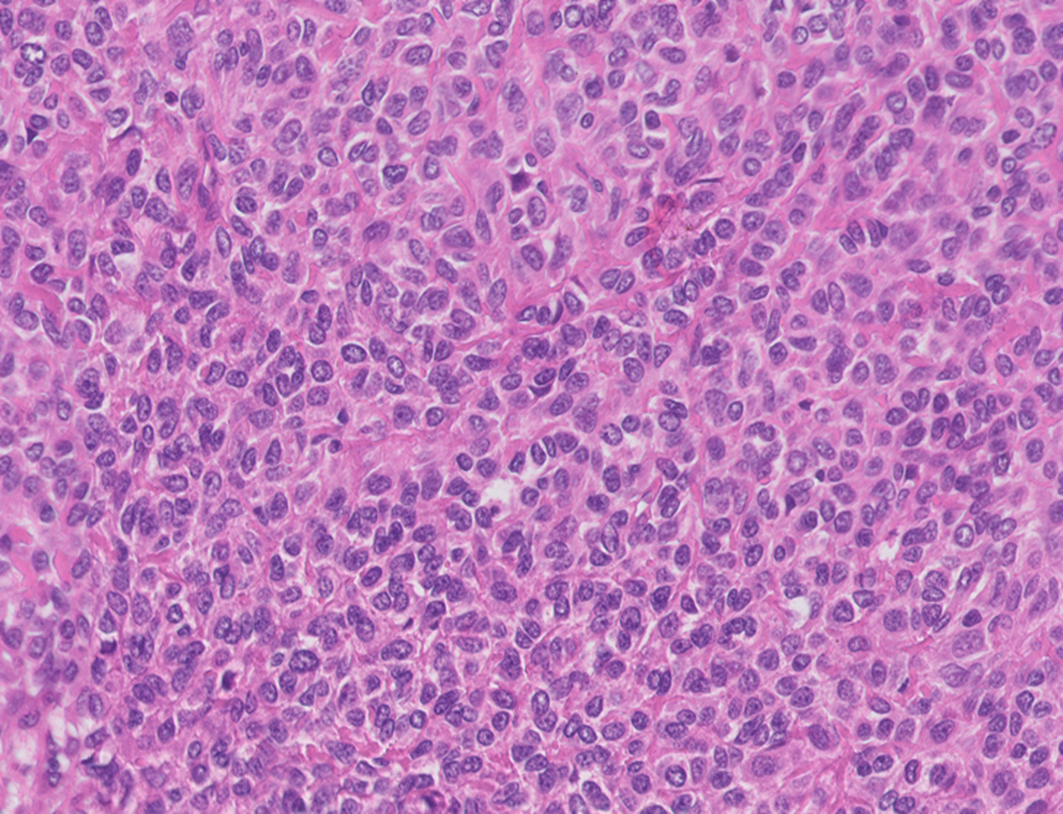
Case 2

Slide 32
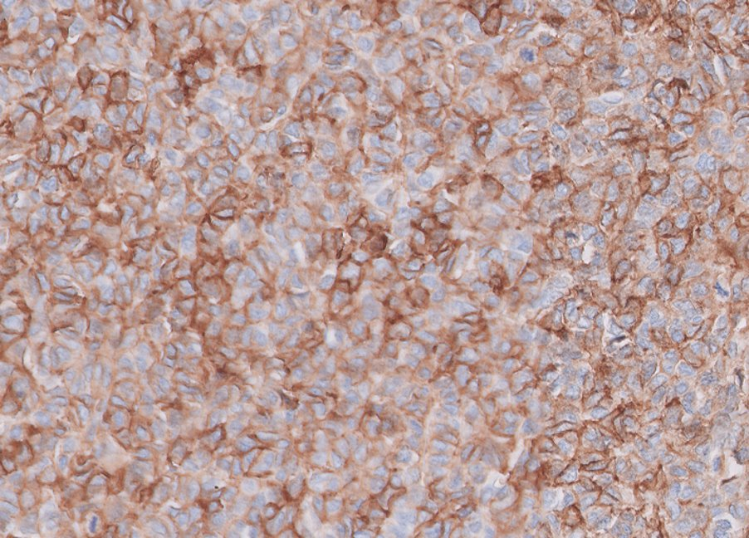
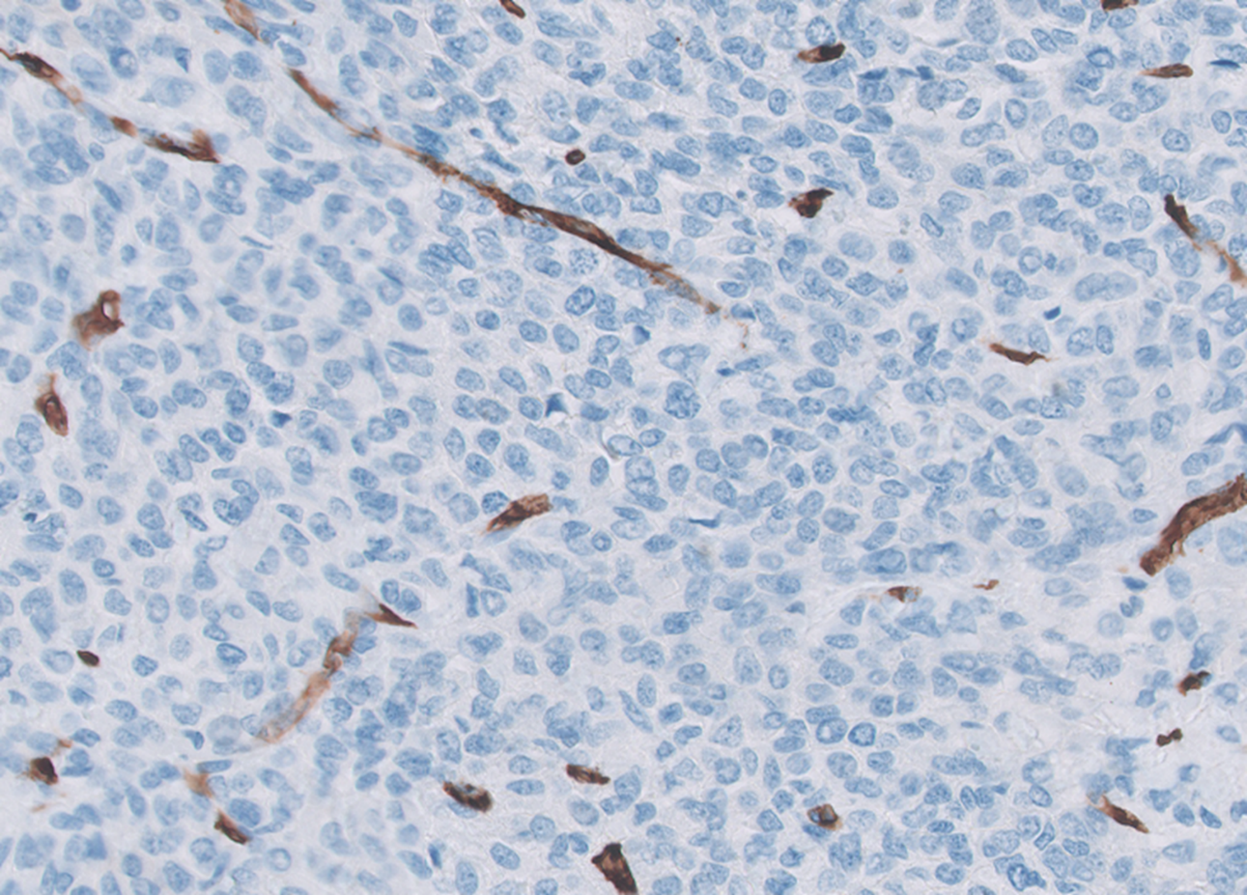
Case 2
CD99
CD34

Slide 33
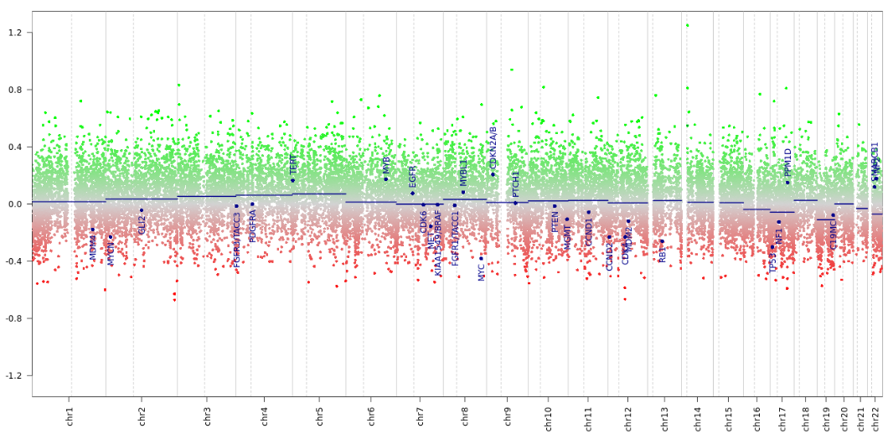
Case 2

Slide 34
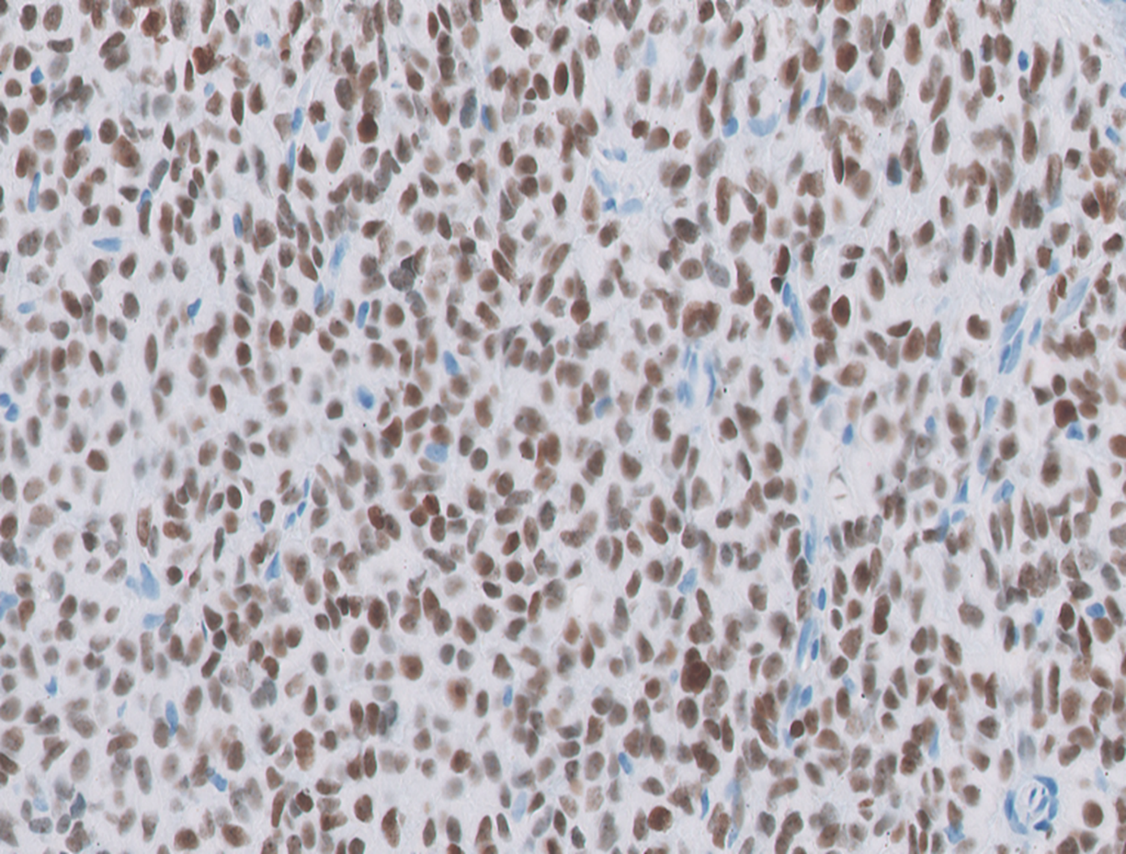
Case 2
STAT-6

Slide 35
Case 2
Integrated Diagnosis
Integrated diagnosis: Solitary fibrous tumor.
Histopathological classification: Spindle cell neoplasm.
WHO grade: Not assigned.
Molecular findings: Methylation class SFT (calibrated score 0,98), flat CNV profile.

Slide 36
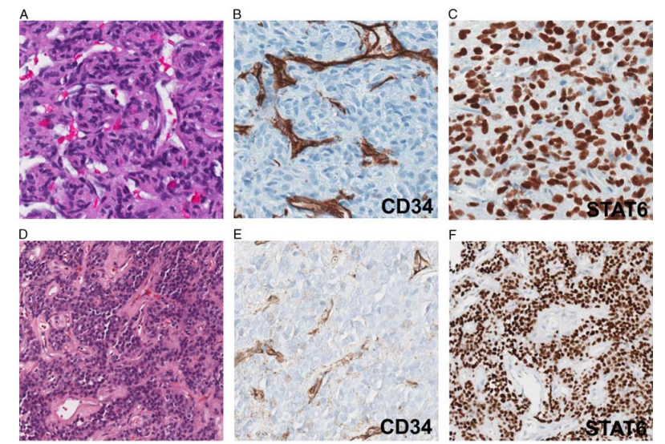

Slide 37
Case 2
Case 3
Female
11-year-old
Extra-axial frontal tumor

Slide 38
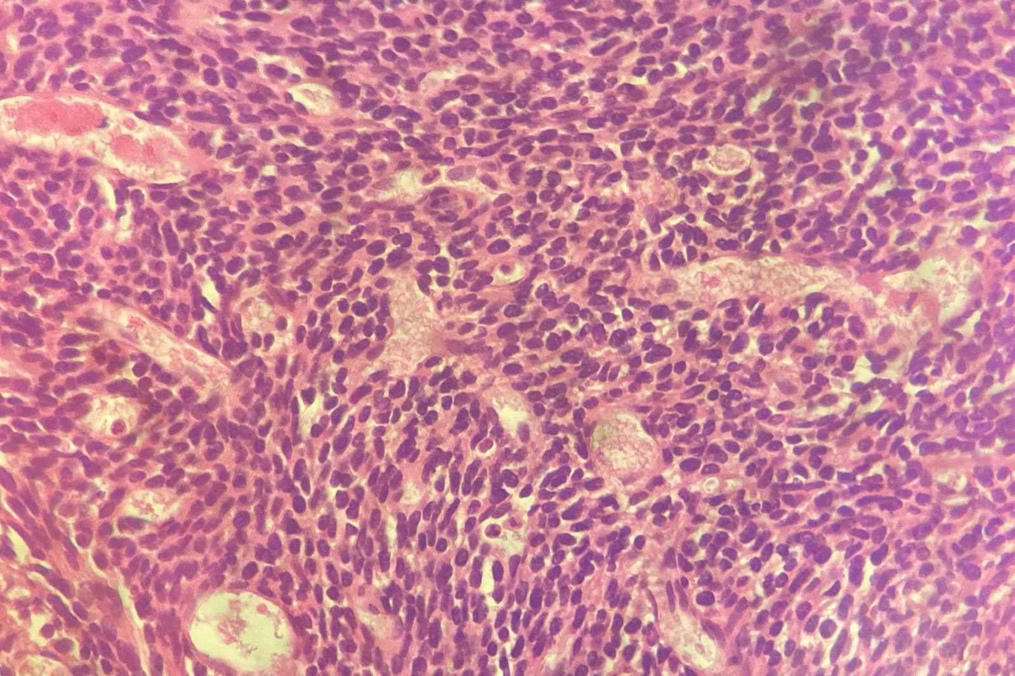
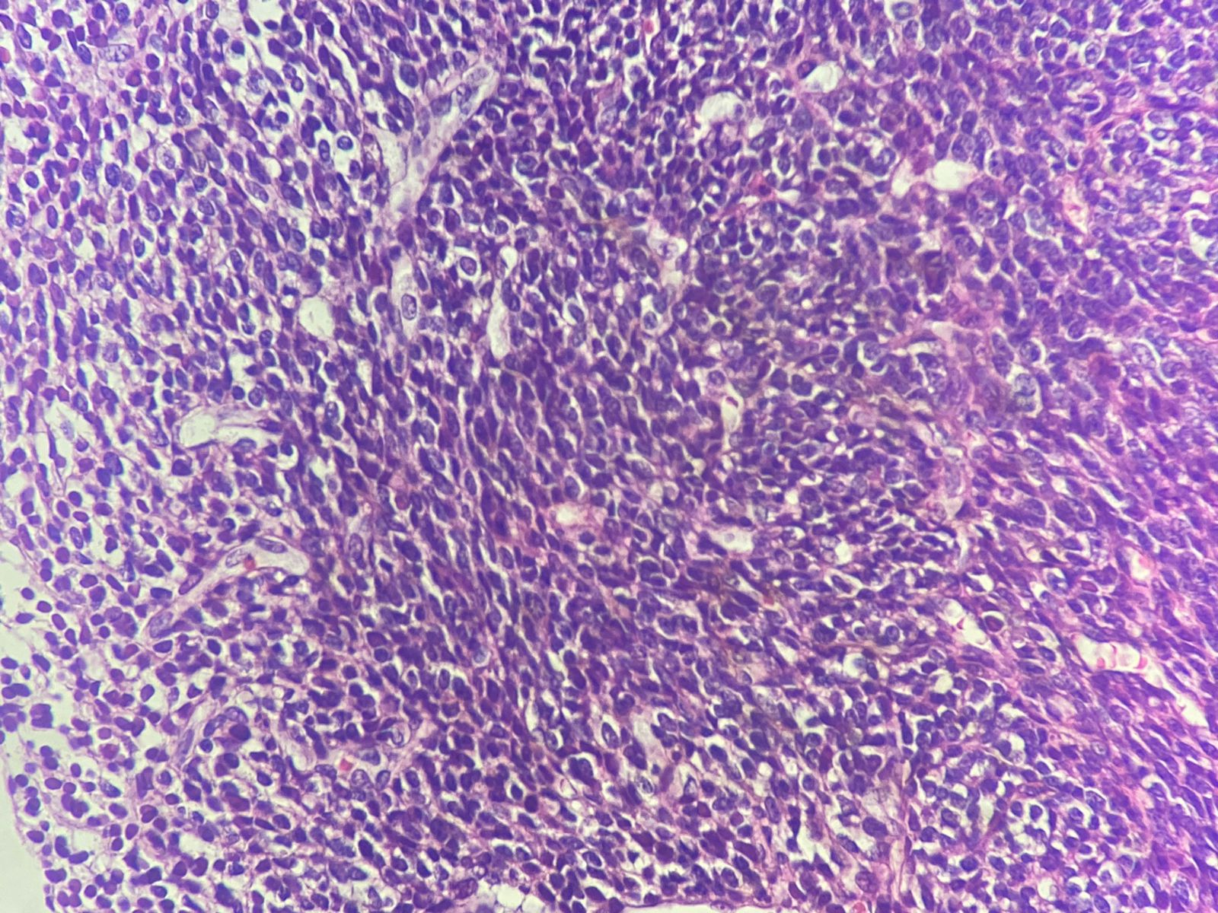

Slide 39
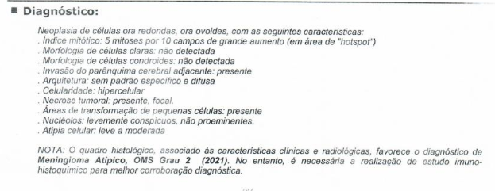
Case 2
Case 3
Female
11-year-old
Extra-axial frontal tumor

Slide 40
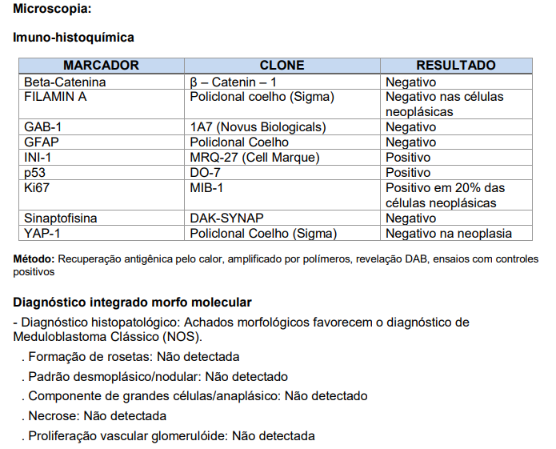

Slide 43
Case 2
Integrated Diagnosis
Integrated diagnosis: Mesenchymal Chondrosarcoma.
Histopathological classification: Small Blue Round Cell Tumor.
WHO grade: High grade.
Molecular findings: Methylation class Mesenchymal Chondrosarcoma (calibrated score 0,99), flat CNV profile.

Slide 45
Case 2
Case 4
Male
14-year-old

Slide 46
Case 2

Slide 47
Case 2

Slide 49
NGS panel

Slide 52
Case 2
Integrated Diagnosis
Integrated diagnosis: High grade conventional Osteosarcoma, metastatic.
Histopathological classification: Sarcoma.
WHO grade: High grade.
Molecular findings: Methylation class Osteosarcoma (high grade) (calibrated score 0,93), aneuploidy in CNV profile.

Slide 53
Case 2
Case 4
Male
14-year-old
Let’s investigate the history…

Slide 54
Case 2
Case 4
Male
14-year-old
Let’s investigate the history…
Bone tumor 4 years earlier…

Slide 55
Case 2
Methylation Profiling as a research tool
Biphenotypic sinonasal sarcomas – Sinonasal cohort
Biphenotypic sinonasal sarcomas – Sarcoma cohort
Gomes NM et al. Presented at Brazilian Congress of Pathology, 2024

Slide 56
Take Home Messages
DNA methylation profiling is a powerful tool in the diagnostic setting – Difficult diagnosis, uncommon presentations, new entities, research
It is already well stablished for use in CNS tumors and also Soft tissue and Bone tumors
Might be used also for Neuroblastomas, Sinonasal tumors and a growing list of tumor types and other applications
Pathologists, biologists and oncologists will need to be able to integrate and interpret multiomic findings in order to achieve precise diagnosis

Slide 57
Obrigado!
Felipe D’Almeida Costa, MD, PhD
Coordenador Médico de Educação em Patologia da DASA
Patologista do A.C.Camargo Cancer Center
Vice-Presidente para Assuntos Acadêmicos da Sociedade Brasileira de Patologia
felipedalmeida@yahoo.com.br (11) 98613-2504 @FelipePatologia

